Slide 1
BREAST CANCER CLASSIFICATION WITH MACHINE LEARNING ALGORITHMS

Slide 2
TABLE OF CONTENTS
About Project
Goals
Dataset Overview
Exploration Data Analysis
Models Selection
Result
Best Model Analysis
Conclusion

Slide 3


DATE
26/02/2025
ABOUT ME
Naftalia Sophiana Purba
Data Scientist | Data Analyst | Machine Learning Enthusiast
Bali, Indonesia
Undergraduate student of Mathematics from Udayana University with a deep interest in Data Analytics, Data Science, and Machine Learning

Slide 4







TOOLS AND LIBRARY

Slide 5
ABOUT PROJECT
ABOUT PROJECT
This project aims to build a machine learning model to classify breast tumors as benign or malignant using the scikit-learn dataset. The tested models include SVM, Logistic Regression, Random Forest, KNN, and Naïve Bayes, compared to determine the best performance in breast cancer classification.
BY : NAFTALIA SOPHIANA PURBA

Slide 6
GOALS
GOALS
The primary objective of this project is to develop an accurate and efficient machine learning model for breast cancer classification using the Scikit-learn dataset. By applying data preprocessing, feature analysis, and evaluating multiple classification algorithms, the project aims to enhance predictive performance and support early cancer diagnosis to assist medical professionals in making informed decisions.
BY : NAFTALIA SOPHIANA PURBA

Slide 7
DATASET OVERVIEW
DATASET OVERVIEW
Source : Scikit-learn
Number of Instances : 569
Number of Features : 30
Feature Types : Numerical
Traget Classes : 0 = Benign (No cancerous tumor)
1 = Malignant (Cancerous tumor)
BY : NAFTALIA SOPHIANA PURBA

Slide 8
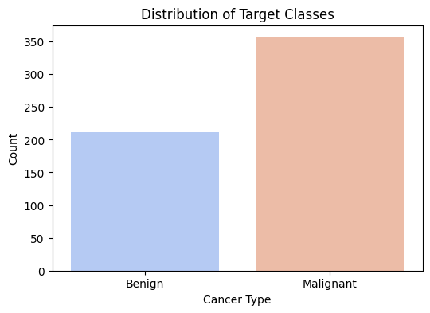
EXPLORATION DATA ANALYSIS
The class distribution in the graph shows that the number of malignant (cancerous) cases is higher than benign (non-cancerous) cases. This provides insight that breast cancer is more frequently detected as malignant in this dataset.
BY : NAFTALIA SOPHIANA PURBA

Slide 9
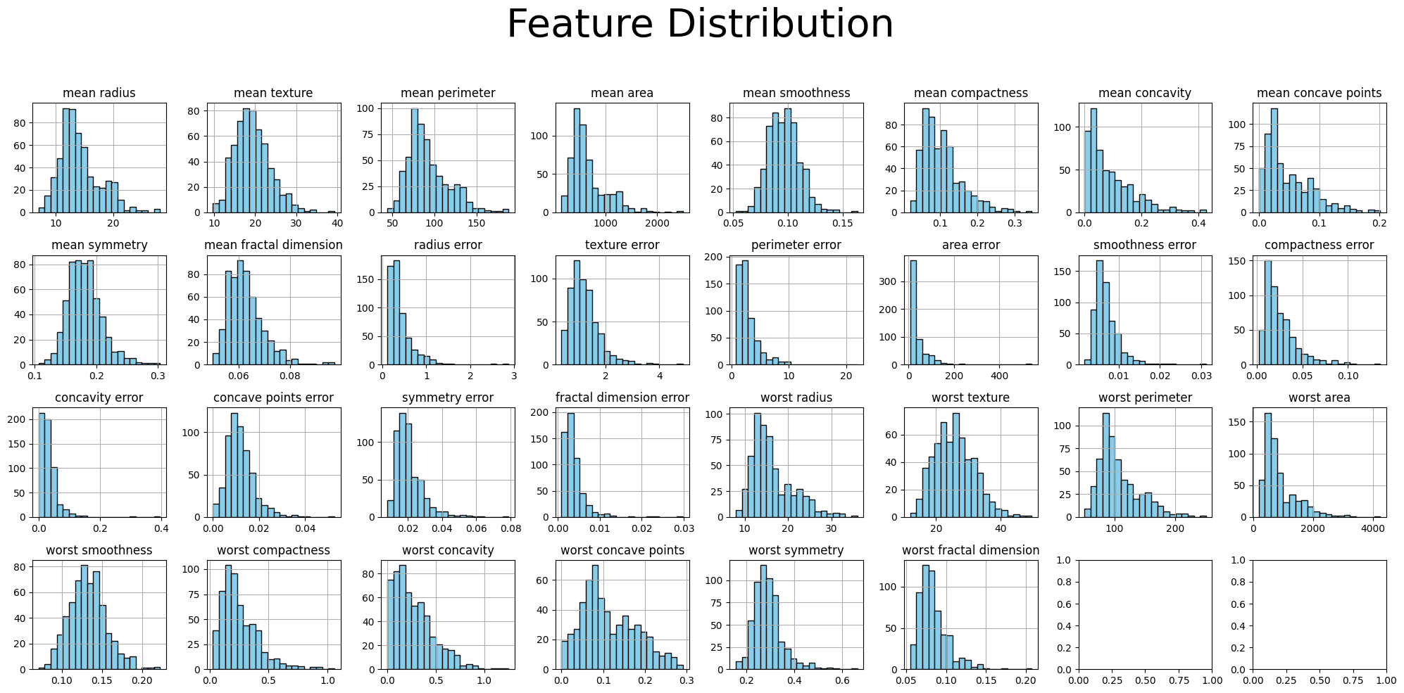
EXPLORATION DATA ANALYSIS
BY : NAFTALIA SOPHIANA PURBA

Slide 10
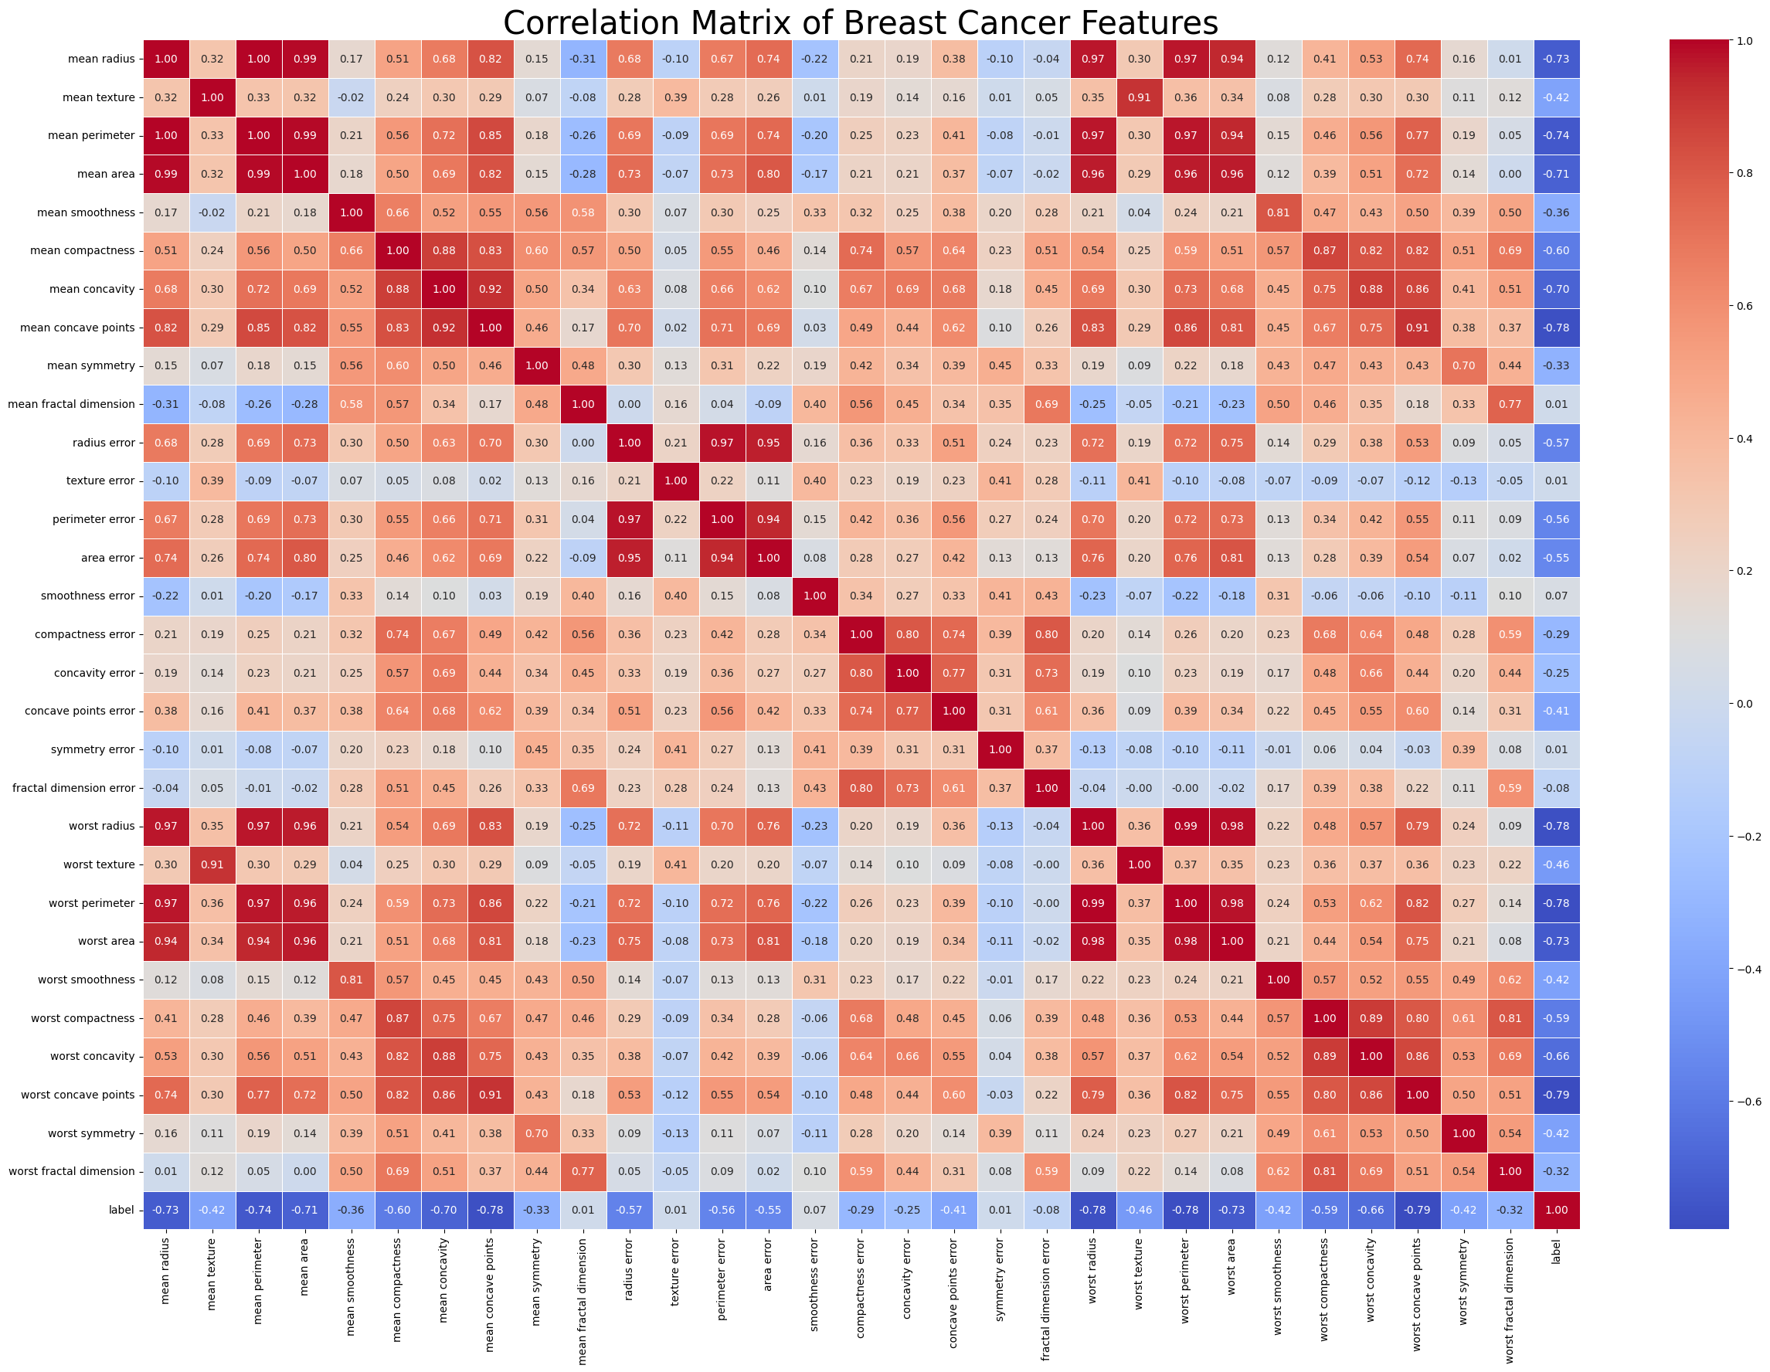
EXPLORATION DATA ANALYSIS
BY : NAFTALIA SOPHIANA PURBA

Slide 11
MODEL SELECTION
MODEL SELECTION
Support Vector Machine (SVM)
Logistic Regression
Random Forest
K-Nearesr Neighbour
Naive Bayes
BY : NAFTALIA SOPHIANA PURBA

Slide 12
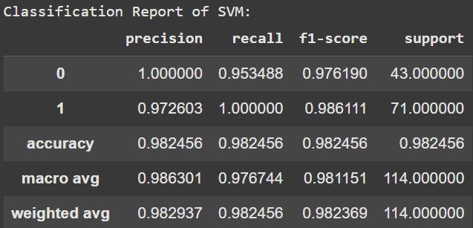
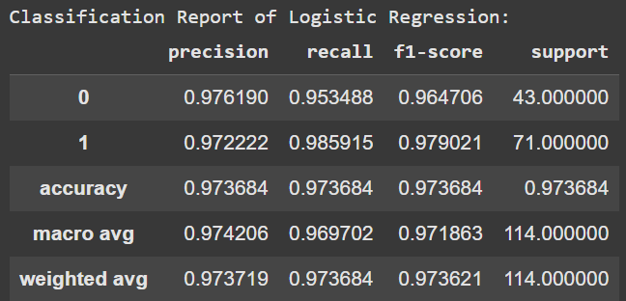
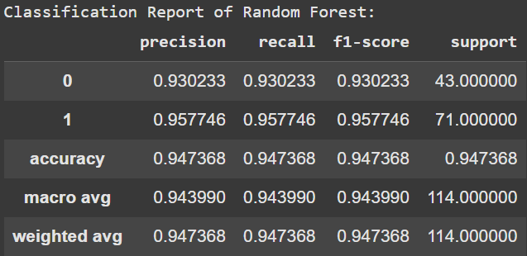
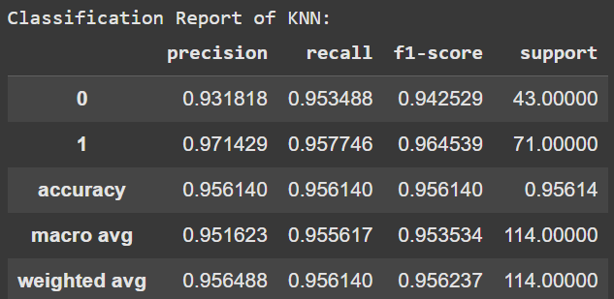
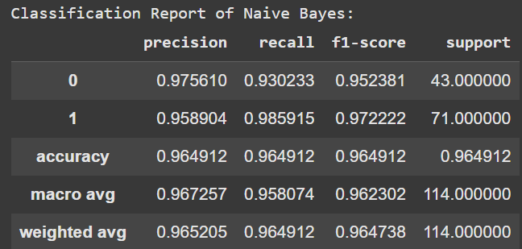
RESULT
BY : NAFTALIA SOPHIANA PURBA

Slide 13
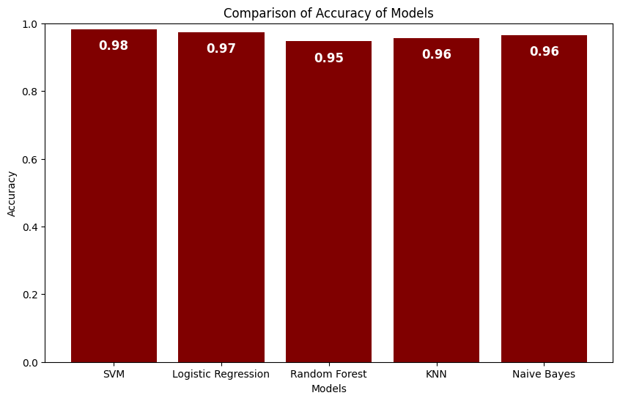
RESULT
Based on the evaluation results of the five models, it was found that the Support Vector Machine has a higher accuracy compared to the other four models, namely Logistic Regression, Random Forest, KNN, and Naive Bayes. Therefore, the next step is to conduct a misclassification analysis and overfitting vs underfitting check.
BY : NAFTALIA SOPHIANA PURBA

Slide 14

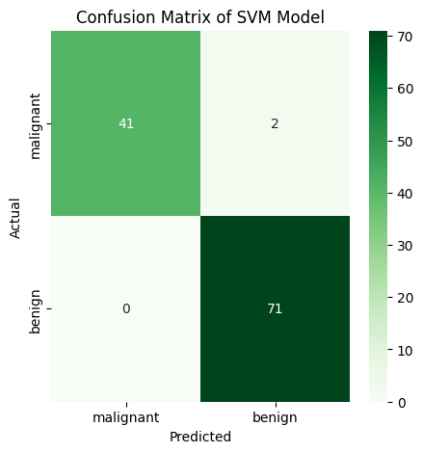
BEST MODEL ANALYSIS
BEST MODEL ANALYSIS
The confusion matrix shows that the SVM model performs well in classifying breast cancer cases. It correctly identifies 41 malignant and 71 benign cases, with only 2 false negatives and no false positives. The high training (98.68%) and testing (97.37%) accuracy indicate that the model generalizes well without signs of overfitting or underfitting.
BY : NAFTALIA SOPHIANA PURBA

Slide 15
CONCLUSION
Breast cancer classification was performed using five machine learning models: SVM, Logistic Regression, Random Forest, KNN, and Naïve Bayes. SVM achieved the highest accuracy (98.25%), making it the best model.
Misclassification analysis showed minimal errors (2 false negatives, 0 false positives). The training (98.68%) and testing (97.37%) accuracies were close, indicating no overfitting or underfitting.
BY : NAFTALIA SOPHIANA PURBA

Slide 16
DATE
26/02/2025
CONTACT
Email : naftaliasphn94@gmail.com
GitHub : https://github.com/naftaliasphna
BREAST CANCER CLASSIFICATION: MACHINE LEARNING APPROACH
BY : NAFTALIA SOPHIANA PURBA

